Slide 1
LECTURE 6: DETERMINANTS AND FACTORS AFFECTING DEMAND

Slide 2
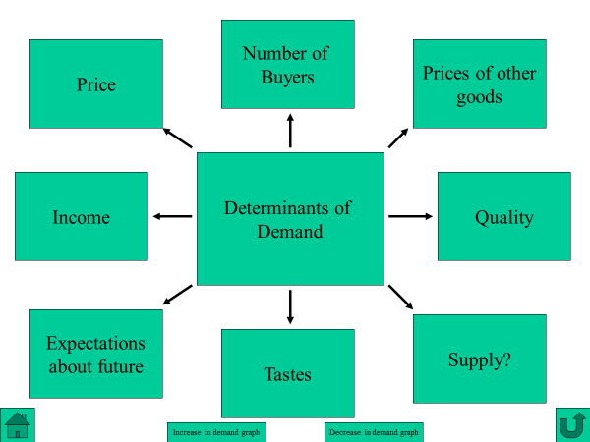
DETERMINANTS OF DEMAND

Slide 3
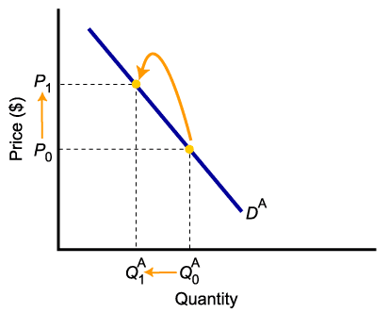
PRICE
Price is the most important determinant of demand.
A “demand curve” plots combinations of prices and quantity demanded.
A change in price causes a movement along the demand curve

Slide 4
FACTORS AFFECTING DEMAND (OR, SHIFT FACTORS OF DEMAND)
1. Income
2. The Prices of Related Goods
3. Tastes and Preferences
4. Expectations about Future Prices and Market Conditions
5. Population/ No of Consumers

Slide 5
INCOME
Ceteris paribus, when people’s income changes, demand change (shifts in demand)
Normal Goods – A good whose demand increases with an increase in income is called a “normal good.”
Inferior Goods –A good whose demand decreases with an increase in income is called an “inferior good.”

Slide 6
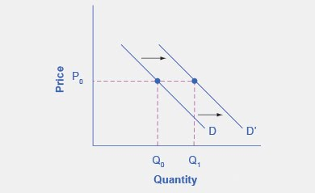
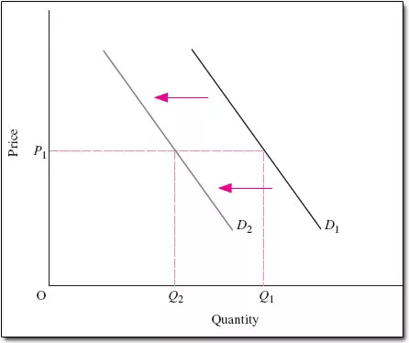
INCOME
Normal Goods – For normal goods demand increases with an increase in income or vice-versa.
Higher income => higher demand
Lower income => lower demand

Slide 7
INCOME
Inferior Goods –For inferior goods demand decreases with an increase in income or vice-versa.
Lower income => higher demand
Higher income => lower demand

Slide 8
PRICES OF RELATED GOODS
Changes in the prices of related goods can increase or decrease demand.
Substitute Goods: Two goods are substitute goods if an increase in price of one good causes an increase in the demand for another good.
Complementary Goods: Two goods are complementary goods if an increase in price of one good causes a decrease in the demand for another good.

Slide 9
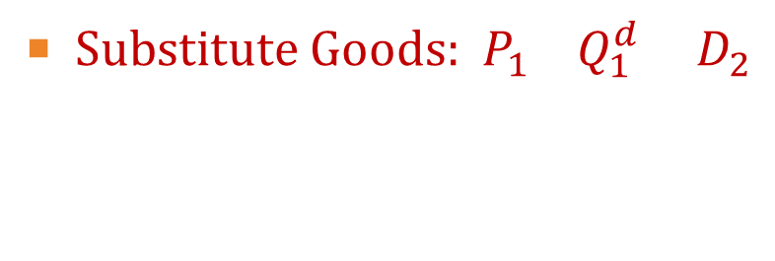
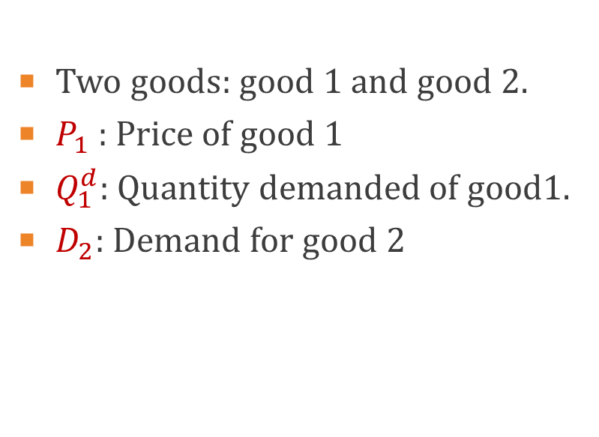
PRICES OF RELATED GOODS

Slide 10
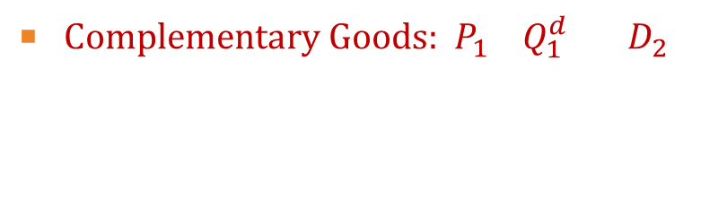

PRICES OF RELATED GOODS

Slide 11
TASTES AND PREFERENCES
Demand curve can shifts due to changes in tastes over time.
Favorable change in taste => higher demand
Unfavorable change in taste => lower demand

Slide 12
EXPECTATIONS ABOUT FUTURE PRICES AND MARKET CONDITIONS
Demand curve can shifts due to changes in expectations.
For example, if you expect the price of computers to fall soon, you may put off buying one until later.
Positive expectation=> higher demand
Negative expectation=> lower demand

Slide 13
POPULATION/ NO OF CONSUMERS
Demand curve can shifts due to changes in population/ no of consumers.
Increase in population/no of consumers => higher demand
decrease in population/no of consumers => lower demand

